Slide 1

Power in dBm conversion to Power in Watts
Buda Tech
dBm (decibel-milliwatts) is a unit that expresses signal strength or power levels, particularly in fields like radio, microwave, and fiber optics. It's a logarithmic scale, relative to one milliwatt (mw),
$$P\left(w\right)={10}^{\left(\frac{P\left(dBm\right)−30}{10}\right)}$$
$$P\left(dBm\right)=10\log_{10}^{P\left(W\right)}{+}30$$

Slide 2

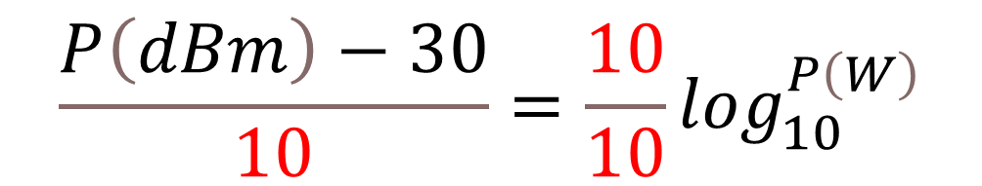
Formula
Buda Tech
From
$$P\left(dBm\right)=10\log_{10}^{P\left(W\right)}{+}30$$
$$P\left(dBm\right)−30=10\log_{10}^{P\left(W\right)}$$
$$\frac{P\left(dBm\right)−30}{10}=\frac{10}{10}\log_{10}^{P\left(W\right)}$$

Slide 3
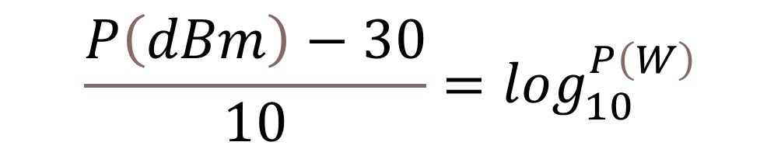

Formula
Buda Tech
$$\frac{P\left(dBm\right)−30}{10}=\frac{10}{10}\log_{10}^{P\left(W\right)}$$
$$\frac{P\left(dBm\right)−30}{10}=\log_{10}^{P\left(W\right)}$$

Slide 4
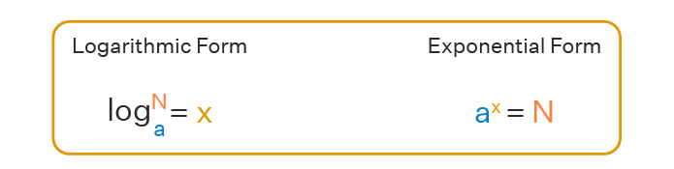


Formula
Buda Tech
$$\frac{P\left(dBm\right)−30}{10}=\log_{10}^{P\left(W\right)}$$
$$P\left(w\right)={10}^{\left(\frac{P\left(dBm\right)−30}{10}\right)}$$

Slide 5



Buda Tech
Convert 47dBm to Watts
$$P\left(w\right)={10}^{\left(\frac{P\left(dBm\right)−30}{10}\right)}$$
$$P\left(w\right)={10}^{\left(\frac{47 − 30}{10}\right)}$$
$P\left(w\right)={10}^{\left(\frac{17}{10}\right)}$ = ${10}^{\left(1.7\right)}$
$$P\left(w\right)=50Watts$$

Slide 6
Buda Tech
Convert 47dBm to Watts
$$P\left(w\right)={10}^{\left(\frac{P\left(dBm\right)−30}{10}\right)}$$
$$P\left(w\right)={10}^{\left(\frac{47 − 30}{10}\right)}$$
$P\left(w\right)={10}^{\left(\frac{17}{10}\right)}$ = ${10}^{\left(1.7\right)}$
$$P\left(w\right)=50Watts$$

Slide 7


Buda Tech
Convert 70 dBm to Watts
$$P\left(w\right)={10}^{\left(\frac{P\left(dBm\right)−30}{10}\right)}$$
$$P\left(w\right)={10}^{\left(\frac{70 − 30}{10}\right)}$$
$P\left(w\right)={10}^{\left(\frac{40}{10}\right)}$ = ${10}^{\left(4\right)}$
$$P\left(w\right)=10000Watts$$

Slide 8
Buda Tech
Convert 70 dBm to Watts
$$P\left(w\right)={10}^{\left(\frac{P\left(dBm\right)−30}{10}\right)}$$
$$P\left(w\right)={10}^{\left(\frac{70 − 30}{10}\right)}$$
$P\left(w\right)={10}^{\left(\frac{40}{10}\right)}$ = ${10}^{\left(4\right)}$
$$P\left(w\right)=10000Watts$$

Slide 9


Buda Tech
Convert 20 dBm to Watts
$$P\left(w\right)={10}^{\left(\frac{P\left(dBm\right)−30}{10}\right)}$$
$$P\left(w\right)={10}^{\left(\frac{20 − 30}{10}\right)}$$
$P\left(w\right)={10}^{\left(\frac{−10}{10}\right)}$ = ${10}^{\left(−1\right)}$
$$P\left(w\right)=0.1Watt$$

Slide 10
Buda Tech
Convert 20 dBm to Watts
$$P\left(w\right)={10}^{\left(\frac{P\left(dBm\right)−30}{10}\right)}$$
$$P\left(w\right)={10}^{\left(\frac{20 − 30}{10}\right)}$$
$P\left(w\right)={10}^{\left(\frac{−10}{10}\right)}$ = ${10}^{\left(−1\right)}$
$$P\left(w\right)=0.1Watt$$

